Slide 1

Simplification of Boolean Functions
Veitch-Karnaugh diagrams

Slide 2
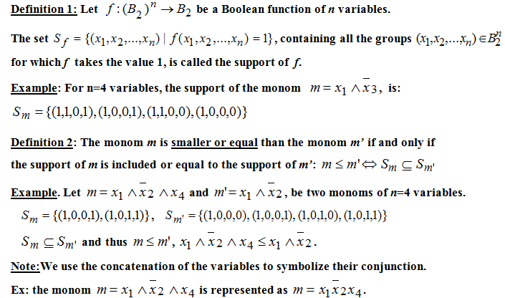
Definitions (I)

Slide 3
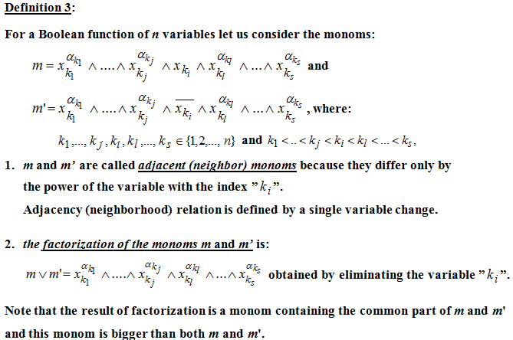
Definitions (II)

Slide 4
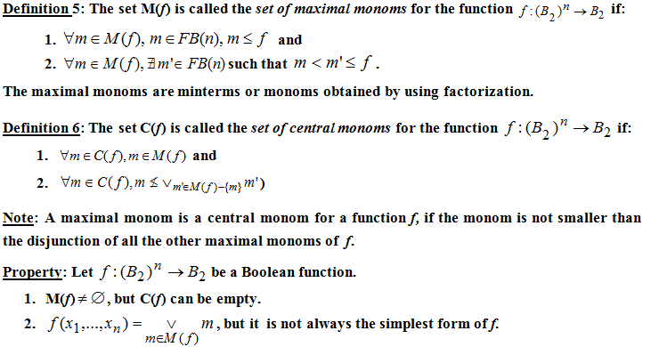
Definitions (III)

Slide 5
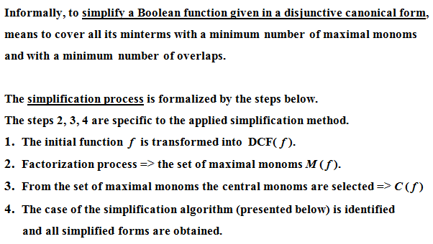
Simplification of Boolean Functions

Slide 6
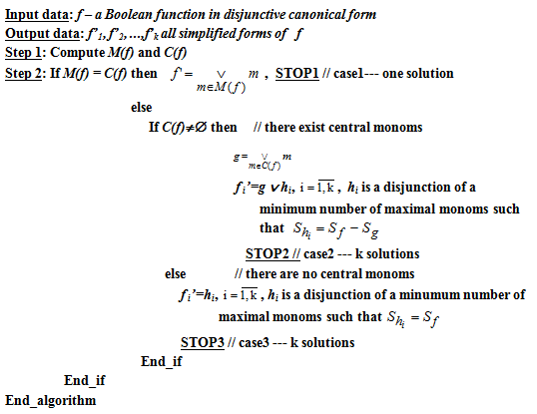
Simplification Algorithm

Slide 7
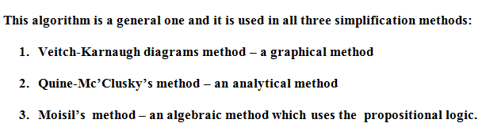
Simplification Methods

Slide 8

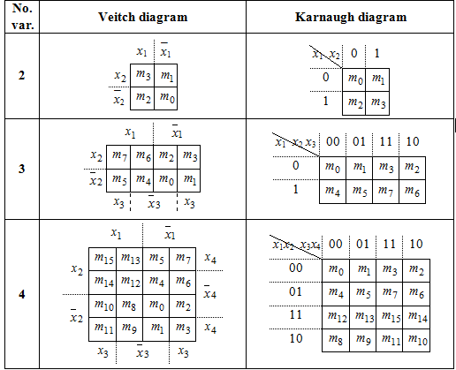
Veitch-Karnaugh Diagrams Method

Slide 9
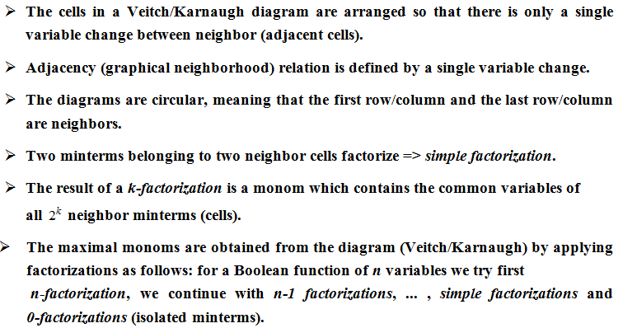
Veitch-Karnaugh Diagrams Method

Slide 10
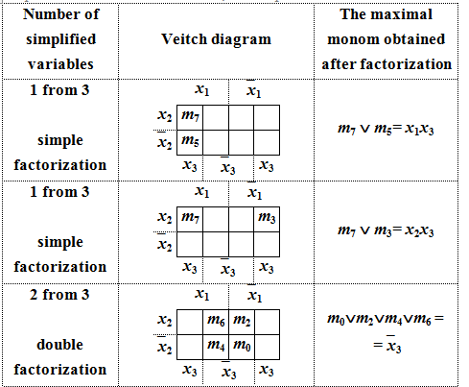
Examples of factorizations (I)

Slide 11
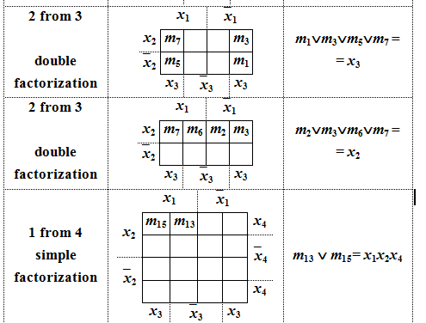
Examples of factorizations (II)

Slide 12

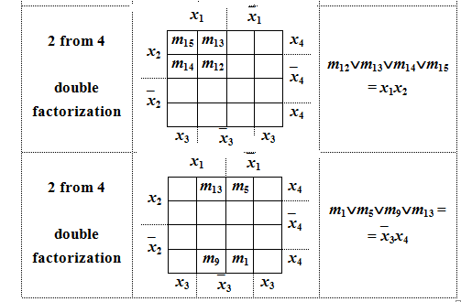
Examples of factorizations (III)

Slide 13

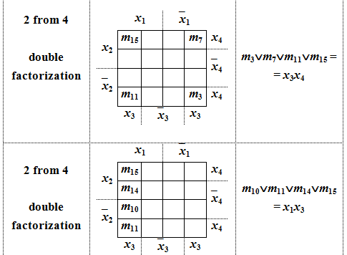
Examples of factorizations (IV)

Slide 14
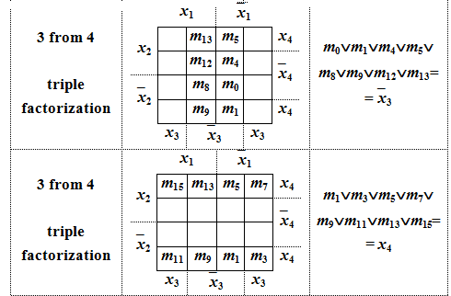
Examples of factorizations (V)

Slide 15
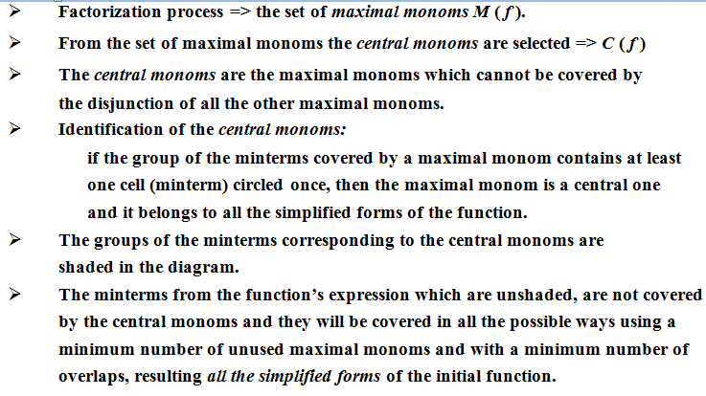
Veitch-Karnaugh Diagrams Method

Slide 16
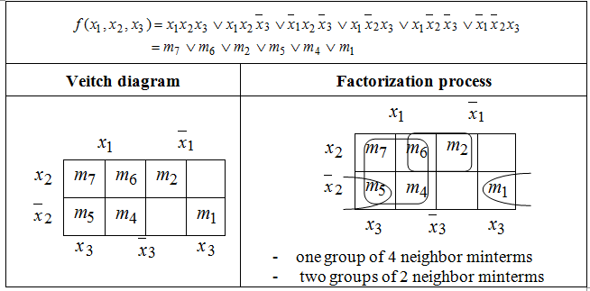
Example 1. simplify the Boolean function:

Slide 17
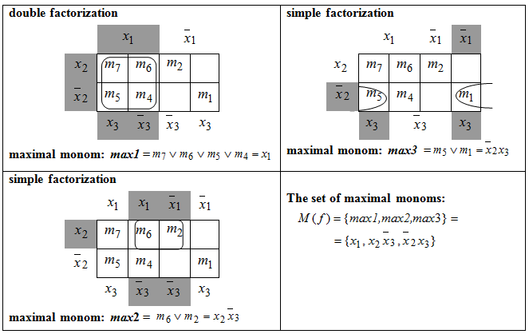
Example 1 – Factorization process

Slide 18
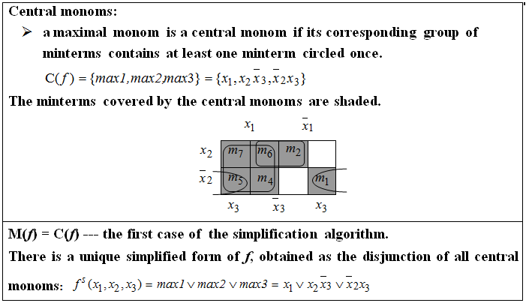
Example 1(contd.)

Slide 19
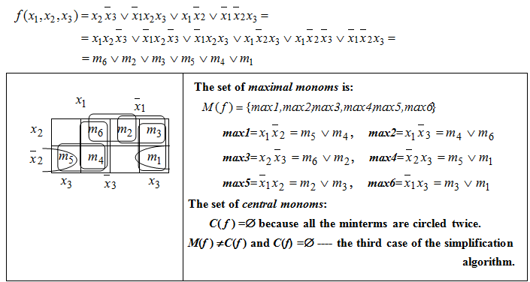
Example 2. simplify the Boolean function:

Slide 20
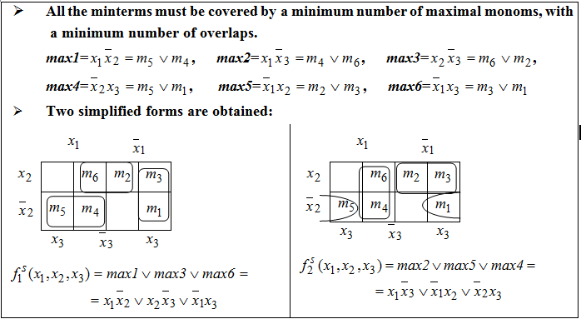
Example 2- Simplified forms

Slide 21
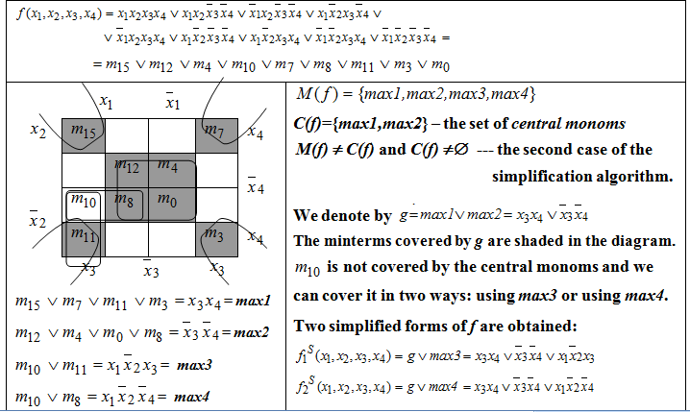
Example 3. simplify the Boolean function

Slide 22
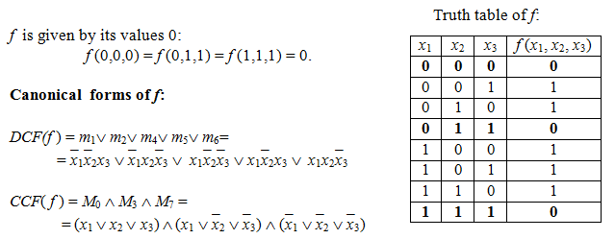
Example 4. simplify the Boolean function

Slide 23
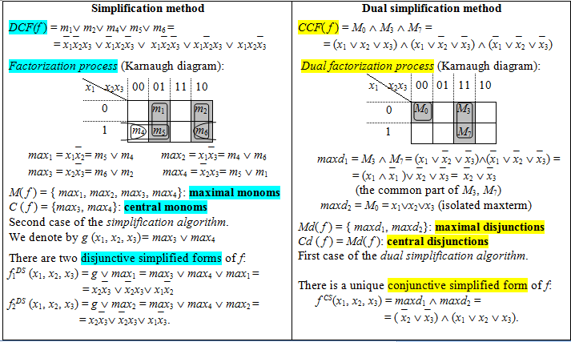
Example 4 (contd.)

Slide 24
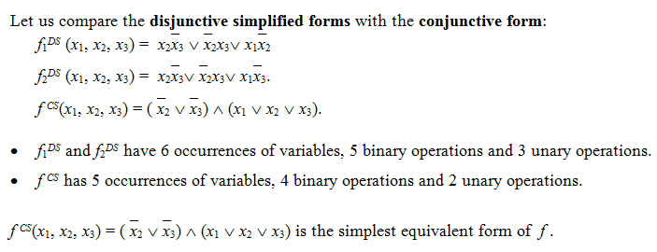
Example 4 (contd.)

